Slide 1
Community Development Block Grant Recovery Housing Program (RHP)
DSHA in partnership with DSAMH
Public Information Session
June 13, 2023

Slide 2
Welcome!
Introductions
DSHA
DSAMH
YOU!

Slide 3
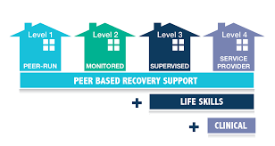
Non-Profit Developers and Service Providers
Goals for Today
Make New Partnerships
Discuss the need for PERMANENT Recovery Housing with Supportive Services
Discuss RHP
Development is complicated process
Providing services is a complicated process
Increase the supply of Recovery Housing in Delaware

Slide 4
What is the RHP?
SUPPORT Act Overview: Public Law 115-271 -SUPPORT for Patients and Communities Act October 24, 2018
In response to the opioid epidemic, Section 8071 authorized the program to aid grantees with providing stable, temporary housing for up to 2 years, to individuals in recovery from a substance use disorder.
Eligible States and the District of Columbia have age-adjusted rates of drug overdose deaths above the national overdose mortality rate.
Based on Community Development Block Grant (CDBG) program under title 1 of Housing and Community Development Act of 1974.

Slide 5
What is Recovery Housing?
Recovery housing is an intervention designed to address the needs of people in recovery from substance use disorder
For safe and healthy living environments
While supplying the requisite recovery and peer supports

Slide 6
Recovery Housing…
Is an essential part of the substance use disorder treatment and recovery continuum of care
Provides safe, healthy, and supportive substance-free living environments
Is centered on peer support and a connection to services that promote long-term recovery
Promotes connections to mutual support groups and recovery support services to reduce isolation and relapse

Slide 7
RHP Funding
Public Law 116-94, Signed December 20, 2019
Appropriated $25 million to program authorized by the SUPPORT Act
RHP Funding (National)
FY 2020 Budget appropriated $25 million to RHP (25 grantees)
FY 2021 Budget appropriated a second round of $25 million (27 grantees)
•The allocation formula includes unemployment rates (15%), labor force nonparticipation (15%), and the age-adjusted rates of drug overdose deaths (70%)
What Did Delaware Receive?
$1,289,213 FY22
$1,313,226 FY23
Notes:
Public Law 116-94, Signed December 20,2019
Appropriated $25 million to program authorized by the SUPPORT Act:
Funds awarded by formula to 25 eligible grantees: 24 States and the District of Columbia
The formula includes unemployment rates (15%), labor force nonparticipation (15%), and the age-adjusted rates of drug overdose deaths (70%)
RHP Funding (National)
FY 2020 Budget appropriated $25 million to RHP (25 grantees)
FY 2021 Budget appropriated a second round of $25 million (27 grantees)
•The allocation formula includes unemployment rates (15%), labor force nonparticipation (15%), and the age-adjusted rates of drug overdose deaths (70%)
•Program rules, waivers, alternative requirements for the first allocation published in the Federal Register in November 2020

Slide 8
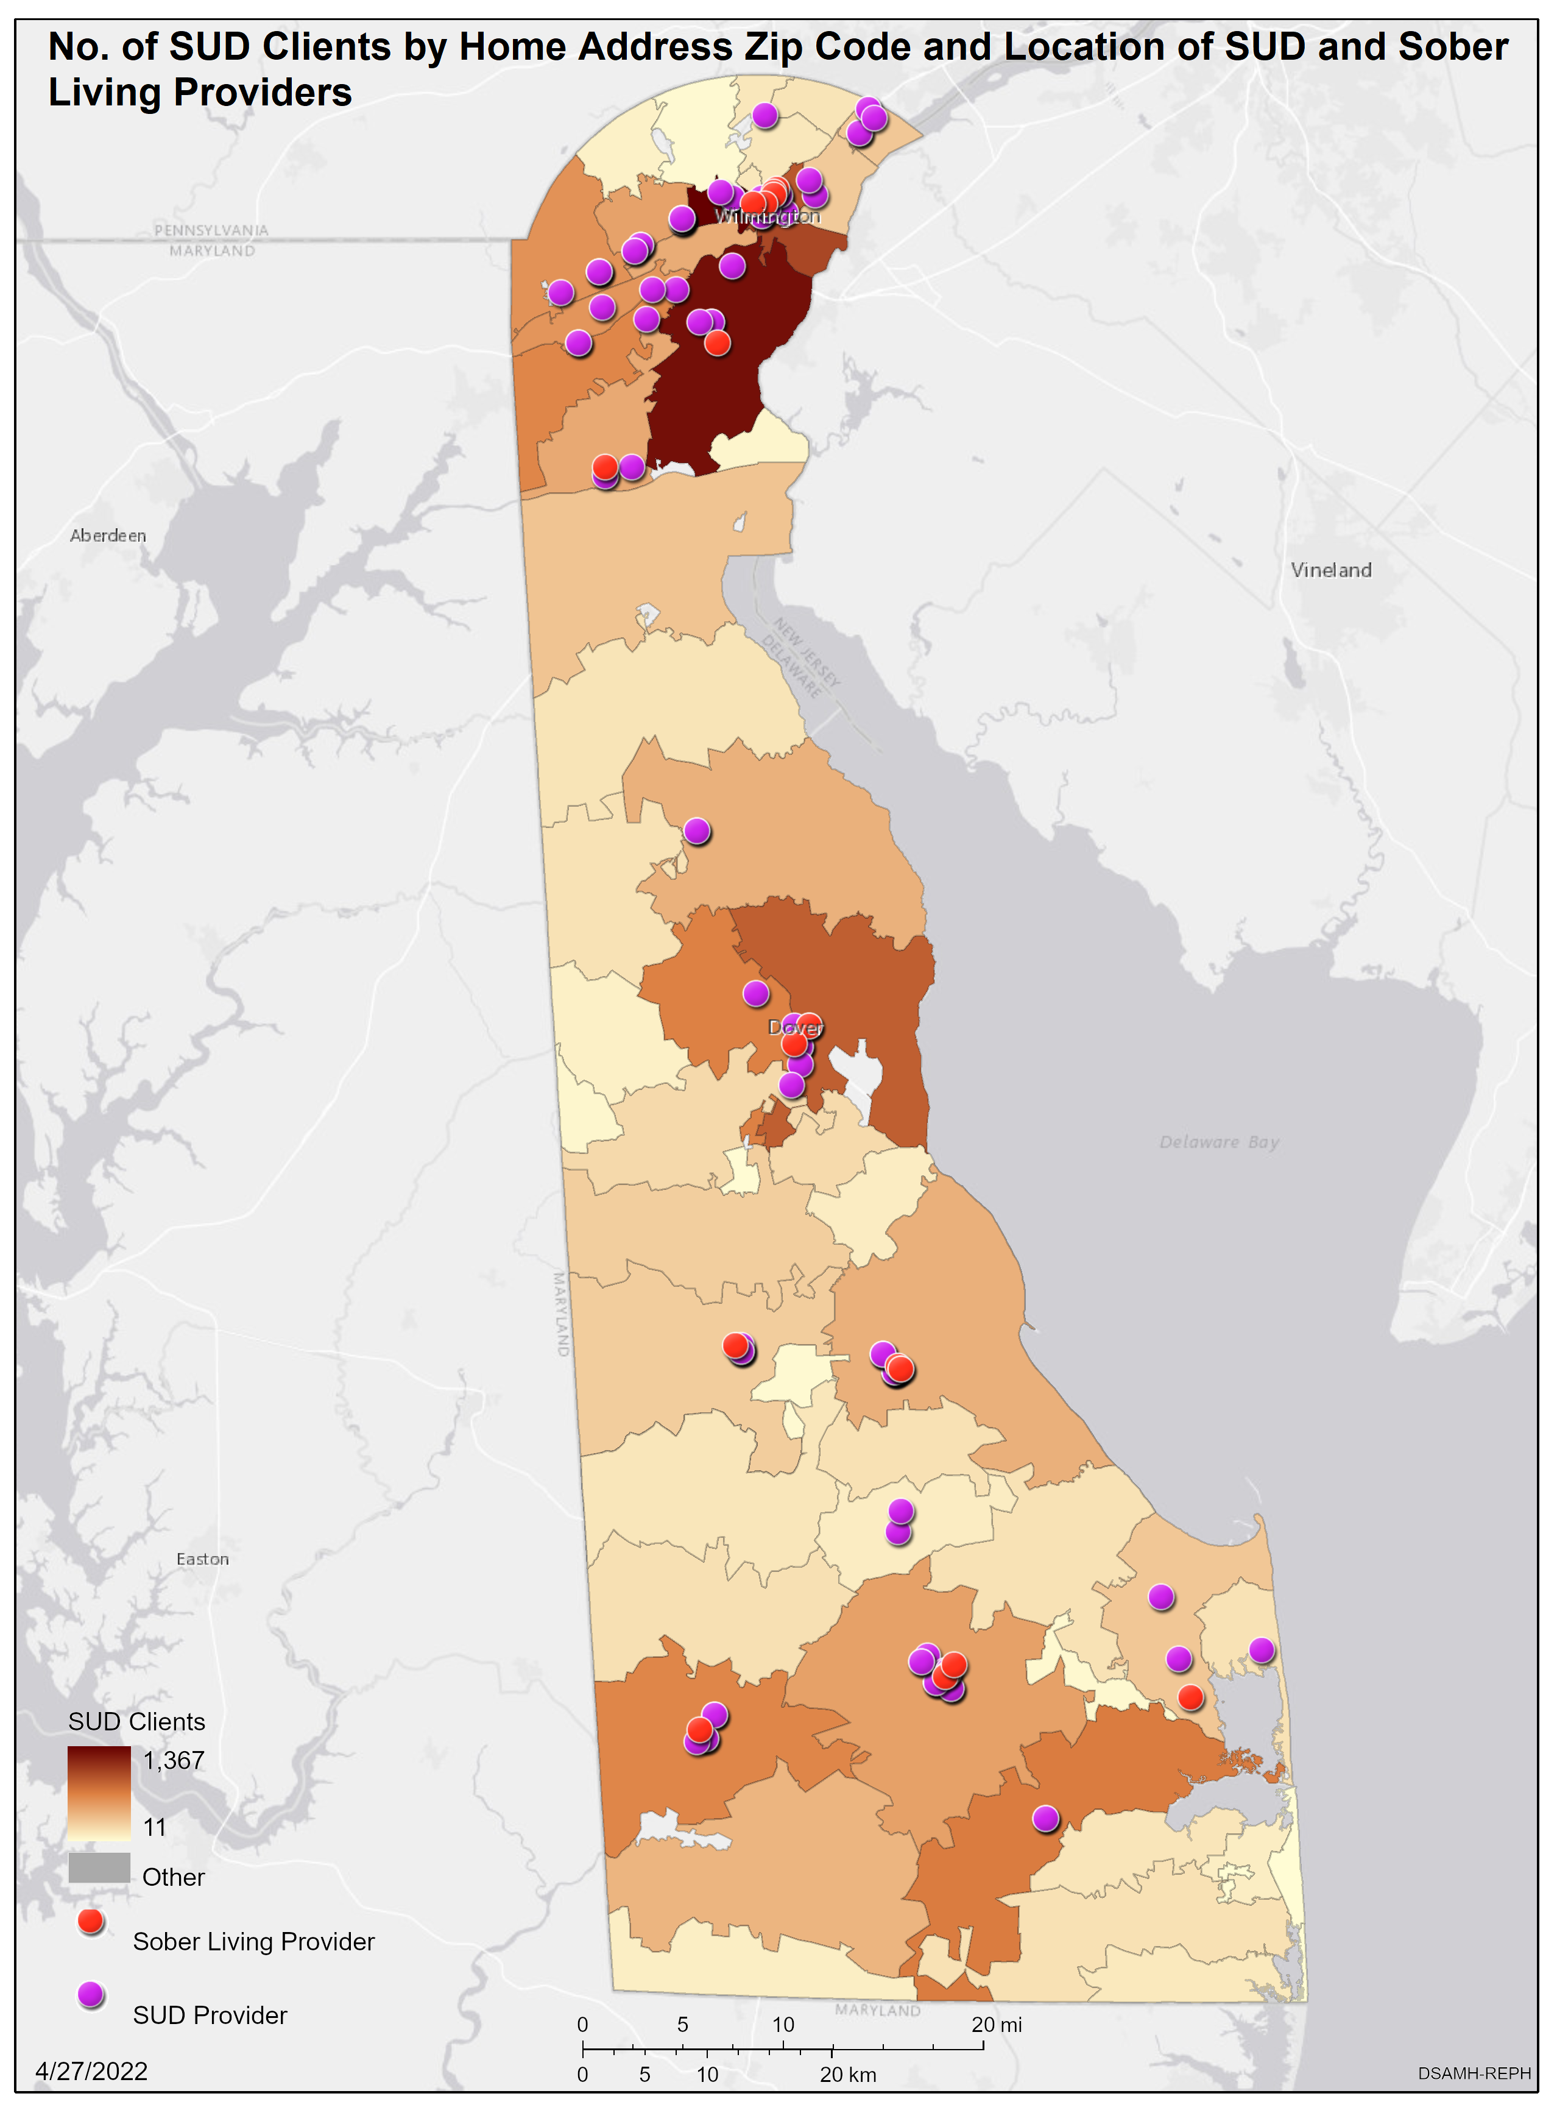
DSAMH AT A GLANCE

Slide 9
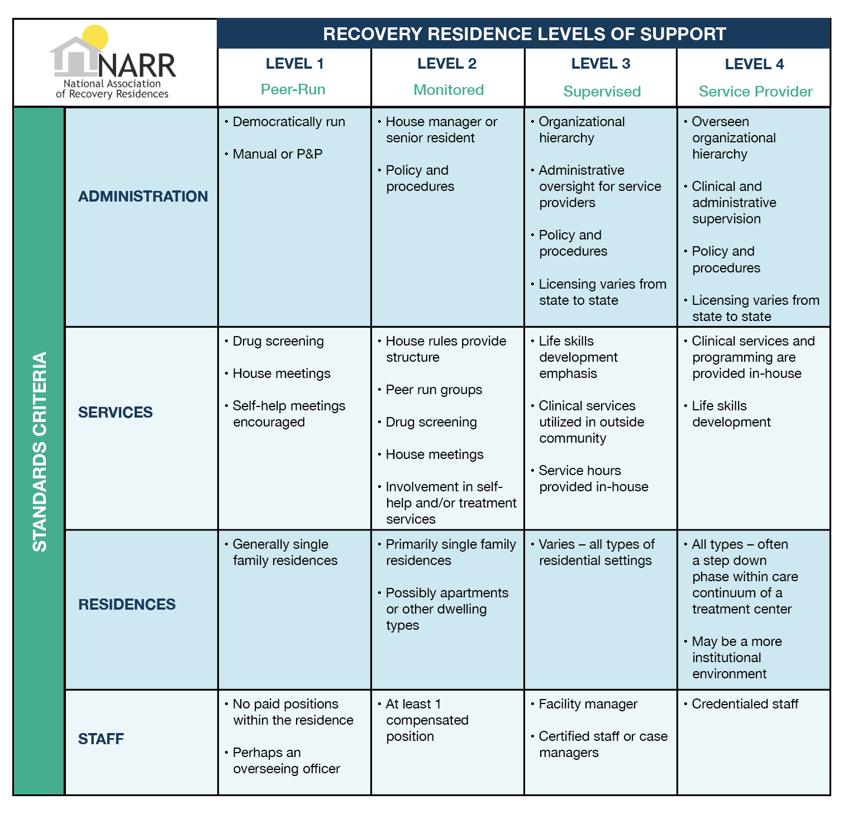
Recovery Residences
NARR Levels of Support
NARR Level 2
NARR Level 3
NARR Level 4
Monitored by one house manager who screens potential residents; shared living environment; services include peer support; drug screening; self-help; referral to clinical services outside the facility
Supervised by a facility manager; staff with certified peer recovery support specialist or case manager; support services include peer support; life skills development emphasis on clinical services provided outside the facility
Integrated Recovery Services
Eligibility of Individual admission based on medical necessity
Licensed treatment services
Notes:
NARR: National Alliance for Recovery Residences
A safe and supportive living environment
alcohol-free and illicit-drug free
The purpose is to provide a healthy living environment for individuals to initiate and sustain recovery.
defined as abstinence from alcohol and other non-prescribed drug use
gain improvement in their physical, mental, spiritual, and social wellbeing.
Addresses the biopsychosocial aspects of the individual in a supportive environment.
Services should include:
a trauma informed approach,
integrating motivational interviewing
evidence-based strategies. The program should be designed to develop the skills necessary to become self-supporting and live a substance-free lifestyle.
NARR II Staffing : House manager or senior resident along with Policies and Procedures
NARRIII Staffing: Facility manager, certified staff or care managers along with Policies and Procedures

Slide 10
Target Population
The target population for DSAMH Contracted Recovery Residences (NARR Levels of Support) are adults (age 18 and over)
Subpopulation priority preference for high-risk populations such as justice-involved, transition age youth, intravenous drug users, pregnant women, parents with dependent children, veterans, LGBTQ+, justice-involved populations, individuals who are attempting to regain custody of their children, families, individuals with Opioid Use Disorder (OUD), and culturally diverse populations
High-risk populations as described above must receive first preference for treatment services. Awardees must describe how they will manage their wait list, with prioritization for these high-risk populations
Notes:
Awardees will provide solutions that include additional integrated services aligned with the NARR IV, including but not limited to:
Intake and assessments;
Outreach and engagement strategies;
Evidence-based health and wellness services;
Recovery-oriented case management interventions and services;
Crisis intervention services;
Harm reduction services; and
Referrals to other community services, such as educational opportunities or vocational services;
Clients currently receiving FDA approved medication (e.g., Buprenorphine, Methadone, Naltrexone, etc.) for their medication assistance needs will not be denied admission, nor will medications be discontinued as a routine condition admission. This also applies to all FDA approved treatment medications for SMI and SUD. Awardees shall explicitly and intentionally provide assessment for appropriate medications which can be initiated prior to discharge to a lower level of care. It is essential existing prescribed medications be maintained in collaboration and coordination with the prescribing medical vendor. BH medications, must be continued in an ambulatory environment. Transportation shall be arranged where appropriate.

Slide 11
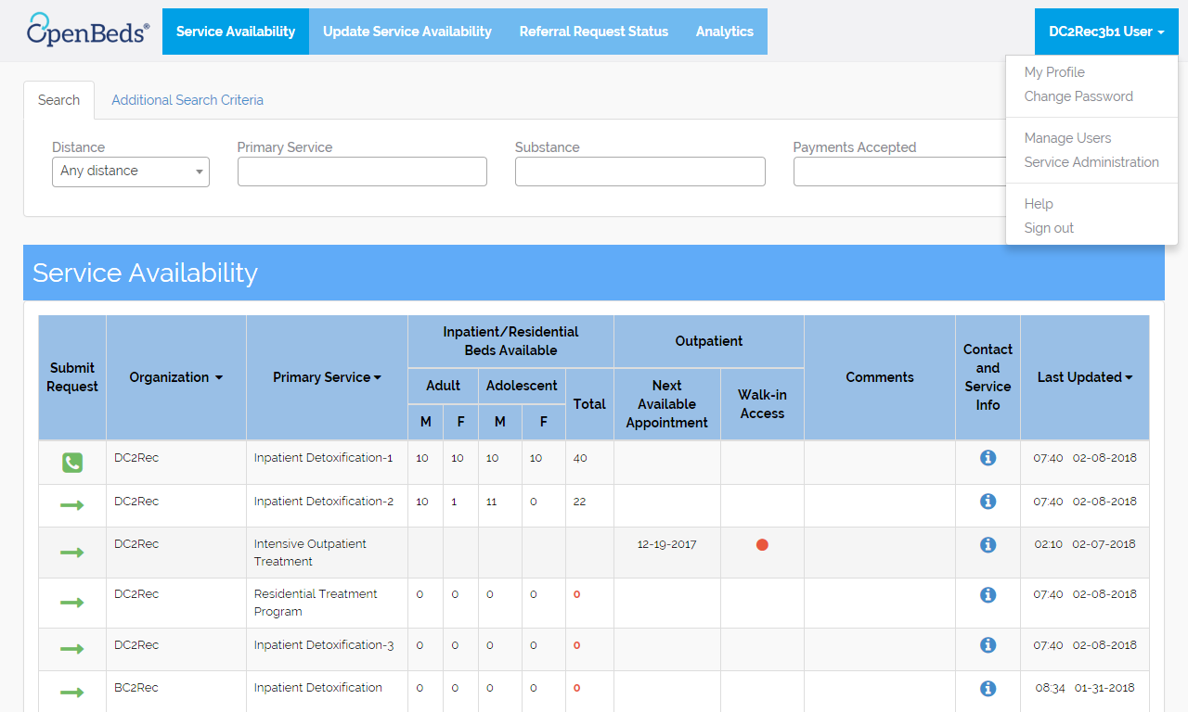
Client Referral Pathway
Improves transitions in care
Connects people to the care that they need
Provides transparency to the referral process
Visibility to where people are falling through the cracks
Use data to identify care gaps and put resources in place to improve
2018
2%
Notes:
Awardees of the project must receive client referrals through DSAMH’s Delaware Treatment and Referral Network (DTRN) which those of you in attendance are already involved.
DTRN is a statewide, comprehensive referral network to help manage transitions of care for behavioral health and substance abuse treatment. DTRN automates the current referral process using a web-based application that securely connects Delawareans to available Behavioral Health care. The Network quickly locates the most appropriate and available level of care and send a electronic referral to a provider, 24 hours a day, seven days a week.
DTRN objectives include:
Quickly identify available destinations and send/receive digital transfer requests securely.
Manage referrals in an easy to use portal via an app on your phone or desktop computer.
Instantly share records, message and manage transitions electronically reducing time on the phone.
Request additional services with within the message the patient may need (food, transportation or housing, etc)

Slide 12
RHP: Main Objectives
1. National Objectives:
Benefit Low-and Moderate-Income Persons based on the Limited Clientele criteria, as modified by the RHP Notice
2. Eligible Activity:
Use funds only for the limited list of eligible activities specified to carry out the purpose of RHP, found in the RHP Notice
3. Connection to Program Purpose:
Provide stable, temporary housing for individuals in recovery from a substance use disorder
RHP is organized within the framework of the Community Development Block Grant, CDBG program.
There are 3 fundamental principles for CDBG compliance

Slide 13
RHP: Eligible Uses & Terms
ELIGIBLE USES
Acquisition Costs
Renovation/Rehab Costs
Pre-development Costs
Environmental Phase I
Appraisal
Capital Needs Assessment
Architectural Design and Oversight
Sprinkler Costs
Closing and Settlement Costs
Capitalized Operating Reserves
TERMS
Amount eligible for – up to appraised value after rehab costs
0% Interest
Acquisition/Rehab will be funded through a draw process;
30 year deferred deed restriction;
Regulatory Requirements
Monitoring Requirements

Slide 14
DSHA Construction & Design Requirements
Must be fully accessible
Sprinkled
Sustainable Products
Meet DSHA Design and Construction Requirements, as applicable (http://destatehousing.com/Landlords/dv_cdbg.php
Capital Needs Assessment
What types of rehab are needed

Slide 15
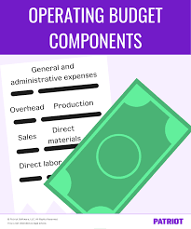
Project Operating Budget
Annual Operating Budget
Annual Services Budget
Operating Expenses
Maintenance Expenses
Water/Sewer
Electric
Exterminating
Audit
Taxes Insurance
Capital Replacement Reserve
RHP Case Management/Peer Supports
Urine Analyses
Transportation
Food
Miscellaneous

Slide 16
DSHA Application
Application Link:
http://www.destatehousing.com/Landlords/dv_cdbg.php
NOFA – Notice of Funding Availability
Details all of the federal and state requirements
What types of recovery projects are eligible
Funding amounts
Application requirements and deadlines
Sources and uses of funding
Scoring and ranking
REVIEW THE NOFA CAREFULLY BEFORE APPLYING

Slide 17
DSHA Application
Application Link:
http://www.destatehousing.com/Landlords/dv_cdbg.php
Applicants must submit one bound and indexed-paper copy and one electronic copy USB thumb drive).
The paper copy must be bound in a three-ring binder in an indexed format, with a table of contents and organized in the following manner:
Table of Contents;
Application, Part I RHP (Signed copy);
Application, Part II RHP Cash Flow Pro Forma; and
Application, Part III RHP Exhibit Checklist (Narratives and support documentation).
The electronic copy may be in the form of a USB thumb drive and should follow the same organizational format as the paper copy described above.

Slide 18
DSHA Application
Applications will be accepted statewide
Hard and USB Copy required
Sub-populations or target populations may be selected
Operating and services budget sources and expenses
Provide Covid policies
Outcomes
CDBG Requirements
Disbursement timelines
Uniform Relocation Act/104(d), if applicable
Section 3
Civil Rights/Fair Housing
Lead Based Paint
Environmental Review
Procurement, if applicable

Slide 19
Review, Scoring & Preliminary Awards
DSHA, DSAMH and other advocates will review and score the applications and make recommendations for the RHP award (s)
Three Part Application will have scoring categories and point ranges established for each criterion to gauge the extent to which the applicant meets the criterion.
Factors will be considered in determining the points assigned.
Collaboration of providers is encouraged

Slide 20
Approvals and Settlement
Municipalities (zoning)
Fire Marshal
DSAMH (contract amendment)
Other Lender or subsidy commitments, if applicable
Entity Counsel must be registered in Delaware to practice
DSHA Counsel will take settlement lead

Slide 21
CONSIDERATIONS
Projects should be10 BEDS or less;
Seller needs to understand the settlement could be 6-12 months;
Renovations/rehab may have delays;
Municipalities and other agencies may have approval or permitting processes;
Acquiring recovery projects that have current service contracts

Slide 22
DSHA Monitoring
Annual Inspections
Asset Management Requirements
Residents may stay up to 24 months (can be non-consecutive)
Resident Income Certification
Area Median Income (AMI)
80% of AMI;
Persons who meet the federal poverty limits; or Persons insured by Medicaid

Slide 23
Process and Timelines
Interest Meeting
Look for Properties
Determine Target Populations
Score, Rank, Preliminary Award
Settlement
Construction
Support Services
On-going Monitoring
Positive Outcomes
Apply to DSHA
Rent Up with OpenBeds
Timeline
6/13- Interest and T/A Meetings
8/11- RHP Application
Due
10/15- Rank, Review, Score Applications; Award
Announcements; Preliminary
Reservations
2024- First Quarter Settlement

Slide 24
?
Questions
RHP Application Contact:
Cindy Deakyne Housing Project Manager Phone: 302-739-0291 Email: Cindy@destatehousing.com | Dawn Favors Jopp Community Development Manager Phone: 302-739-0204 E-mail: dawn@destatehousing.com

